Slide 1

L-Shapley and C-Shapley: Efficient Model Interpretation for Structured Data
Jianbo Chen, Le Song, Martin J. Wainwright, Michael I. Jordan
ICLR 2019
February 28, 2020
Presenter: Rishab Bamrara
https://qdata.github.io/deep2Read/

Slide 2
Motivation:
Modern machine learning models, including random forests, deep neural networks, and kernel methods, can produce high accuracy prediction in many applications. However, the accuracy in prediction from such black box models, comes at the cost of interpretability.
Ease of interpretation is a crucial criterion when these tools are applied in areas such as medicine, financial markets, and criminal justice

Slide 3
Background:
Approaches for Interpreting Models:
Model specific Interpretation: Make assumptions to the model and hence are specific to the model itself. (Attention weights, smooth-grad, grad-CAM)
Model Agnostic Interpretation: Making no assumptions about the underlying model. Can be used in any ML model and is applied post-hoc. (Eg. LIME, Shapley value)
Instance-wise Interpretation: Yielding feature importance for each input instance. (E.g. Saliency Map, CD)
Model-level Interpretation: Yielding feature importance for the whole model. (E.g. Weights of NN, Decision Rules for Decision Trees)
This study focuses on Model Agnostic and Instance-wise Interpretation.

Slide 4
Background:
Shapley Value:
Axiomatic characterization of a fair distribution of a total surplus from all the players.
Can be applied in to predictive models.
Each feature is modeled as a player in the underlying game.
For quantifying the importance of a given feature index i for feature vector x ∈ R^{d}, we can compute importance score of feature i, v_{x}({i}), on its own.
However, doing so ignores interactions between features, which are likely to be very important in applications.

Slide 5
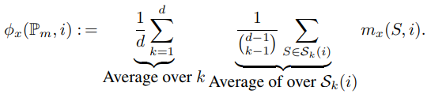
Background:
Marginal Contribution: For a given subset S containing i, compute the difference between the importance of all features in S, with and without i.
m_{x}(S, i) : = v_{x}(S) − v_{x}(S \ {i})
In order to obtain a simple scalar measure for feature i, we need to aggregate these marginal contributions over all subsets that contain i.
S_{k}(i) denote the set of k-sized subsets that contain i.

Slide 6
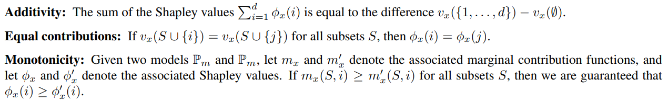
Background:
Properties of Shapley Value:
Challenge with computing Shapley values:
The exact computation of the Shapley value φx(i) takes into account the interaction of feature i with all 2 ^{d−1} subsets that contain i, thereby leading to computational difficulties.

Slide 7
Related Work:
Lloyd S Shapley. (1953): A value for n-person games. Contributions to the Theory of Games
Štrumbelj et al. (2010): An efficient explanation of individual classifications using game theory.
Datta et al. (2017): Algorithmic transparency via quantitative input influence: Theory and experiments with learning systems.
Lundberg et al. (2009): A unified approach to interpreting model predictions.
Monte Carlo Approximation and Weighted linear regression.

Slide 8
Claim / Target Task:
Sampling-based approximations may suffer from high variance when the number of samples to be collected per instance is limited.
For large-scale predictive models, the number of features is often relatively large, meaning that the number of samples required to obtain stable estimates can be prohibitively large.
Authors address this challenge in a model-based paradigm, where the contribution of features to the response variable respects the structure of an underlying graph.
Notes:
Here, we make the claim of this project.

Slide 9
Method:
Associate features with the nodes of a graph. E.g. sequence data can be associated with a line graph and grid graph for image data.
Notations:
x ∈ R^{d} ⇒ feature vectors
G = (V, E) ⇒ Graph with nodes V and edges E ⊂ V x V
Each feature i is associated with a node i ∈ V
Edges represent interactions between features
d_{G}(l, m) ⇒ number of edges in shortest path joining l to m.
K-neighborhood ⇒ N_{k}(i) : = {j ∈ V | d_{G}(i, j) ≤ k}
Notes:
Here, we make the claim of this project.

Slide 10
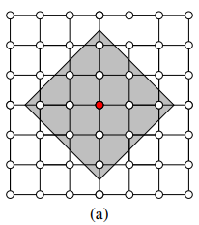
Method:
Illustration of the k = 2 graph neighborhood N₂(i) on the grid graph. All nodes within the shaded gray triangle lie within the neighborhood N₂(i).
Notes:
Here, we make the claim of this project.

Slide 11
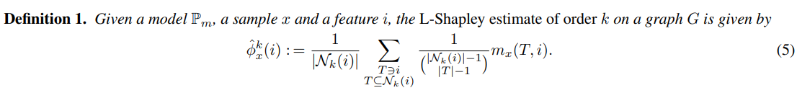
Local Shapley (L-Shapley)
Words distant have a weaker influence on the importance of a given word in a document, and therefore have relatively less effect on the Shapley score.
Original Formula:
Notes:
Here, we make the claim of this project.

Slide 12
Local Shapley (L-Shapley)
Coefficients of m_{x}(S, i) are chosen to match the coefficients in the definition of the Shapley value restricted to the neighborhood N_{k}(i).
This controls the error under certain probabilistic assumption.
The choice of the integer k is dictated by computational considerations.
Evaluating all d L-Shapley scores on a line graph requires 2^{2k}d model evaluations. (2 ^{2k+1} per feature).
A grid graph requires 2^{4k*4k}d function evaluations.
Notes:
Here, we make the claim of this project.

Slide 13
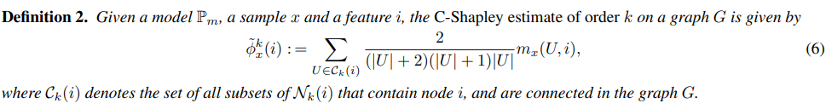
Connected Shapley (C-Shapley)
Further reduces the complexity of approximating the Shapley value.
Only look at the connected subsets.
It is not heartwarming or entertaining. It just sucks.
Subset “It not heartwarming,” rarely appears in real data and may not make sense to a human or a model trained on real-world data.
Notes:
Here, we make the claim of this project.

Slide 14
Connected Shapley (C-Shapley)
Coefficients of m_{x}(S, i) are a result of using Myerson value.
The error between C-Shapley and the Shapley value can also be controlled under certain statistical assumptions.
For text data, C-Shapley is equivalent to only evaluating n-grams in a neighborhood of the word to be explained.
C-Shapley scores for all d features takes O(k²d) model evaluations on a line graph.
Notes:
Here, we make the claim of this project.

Slide 15
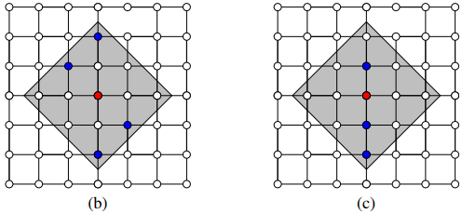
Difference b/w L-Shapley and C-Shapley
(b) A disconnected subset of N₂(i) that is summed over in L-Shapley but not C-Shapley.
(c) A connected subset of N₂(i) that is summed over in both L-Shapley and C-Shapley.
Notes:
Here, we make the claim of this project.

Slide 16
Approximation of Shapley value
The expected error between the L-Shapley estimate φˆ^{k}_{X}(i) and the true Shapley-value-based importance score φ_{i}(P_{m}, x) is bounded by 4ε:
E_{X}|φˆ^{k}_{X}(i) − φ_{X}(i)| ≤ 4ε.
The expected error between the C-Shapley estimate φˆ^{k}_{X}(i) and the true Shapley-value-based importance score φ_{i}(Pm, x) is bounded by 6ε:
E_{X}|φˆ^{k}_{X}(i) − φ_{X}(i)| ≤ 6ε
Notes:
Here, we make the claim of this project.

Slide 17

Speeding Up Calculation:
For considering the interaction of features in a large neighborhood N_{k}(i) with a feature i, exponential complexity in k can become a barrier.
Sampling based on random permutation (Štrumbelj et. al.) of local features may be used to alleviate the computational burden of L-Shapley.
A regression-based estimate of C-Shapley :
Where, X ∈ {0, 1}^{kd×d} and a response vector F ∈ R^{kd}, where X_{ij} = 1 if the jth feature is included in the ith sample, and F_{i} = v_{x}(S_{i}), the score function evaluated on the corresponding feature subset.
Notes:
Here, we make the claim of this project.

Slide 18
Problem Setting
Input:
Model
Instance
Output:
A vector of importance score of the feature.
The instance-wise property means that this vector, and hence the relative importance of each feature, is allowed to vary across instances.

Slide 19
Experiments:
Task: Image Classification and Text Classification
Baselines: Model Agnostic Methods
KernelSHAP: Regression based approximation of Shapley.
SampleShapley: Random sampling based approximation.
LIME: Linear model to locally approximate the original model.
Saliency Map: Image Data
Notes:
Here, we make the claim of this project.

Slide 20
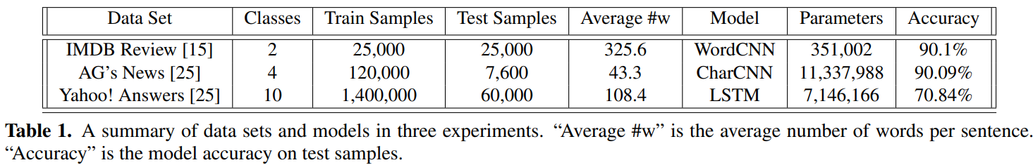
Datasets for Text Classification:
IMDB Review ⇒ Word-CNN
AG News ⇒ Char-CNN
Yahoo! Answers ⇒ LSTM
L-Shapley ⇒ Interaction of each word i with the two neighboring words in N₁(i)
C-Shapley ⇒ Regression-based version on all n-grams with n ≤ 4.
Notes:
Here, we make the claim of this project.

Slide 21
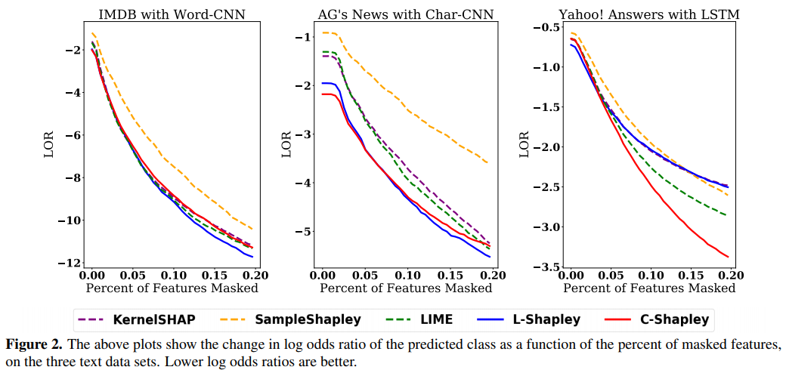
Results:
On IMDB with Word-CNN, L-Shapley achieves the best performance while LIME, KernelSHAP and C-Shapley achieve slightly worse performance.
On AG’s news with Char-CNN, L-Shapley and C-Shapley both outperform other algorithms.
On Yahoo! Answers with LSTM, C-Shapley outperforms the rest of the algorithms by a large margin
Notes:
Here, we make the claim of this project.

Slide 22
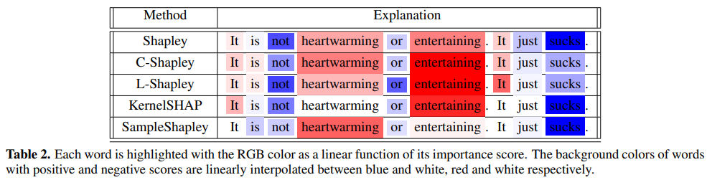
Results:
Importance scores produced by different Shapley-based methods on Example:
“It is not heartwarming or entertaining. It just sucks”.
Notes:
Here, we make the claim of this project.

Slide 23
Datasets for Image Classification:
MNIST
CIFAR10
Notes:
Here, we make the claim of this project.

Slide 24
Evaluation:
SampleShapley
KernelSHAP
Saliency
C_Shapley
LIME and L-Shapley are not used for comparison.
LIME uses superpixels instead of raw pixels.
L-Shapley was not chosen because of evaluation constraints.
For C-Shapley, applied regression-based version to evaluate all n×n image patches with n ≤ 4.
Notes:
Here, we make the claim of this project.

Slide 25
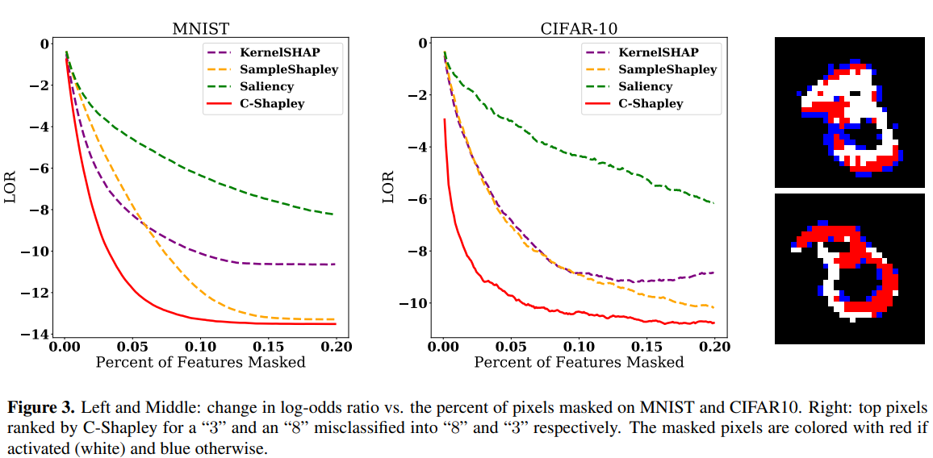
Results:
Interestingly, the top pixels chosen by C-Shapley visualize the “reasoning” of the model: more specifically, the important pixels to the model are exactly those which could form a digit from the opposite class.
Notes:
Here, we make the claim of this project.

Slide 26
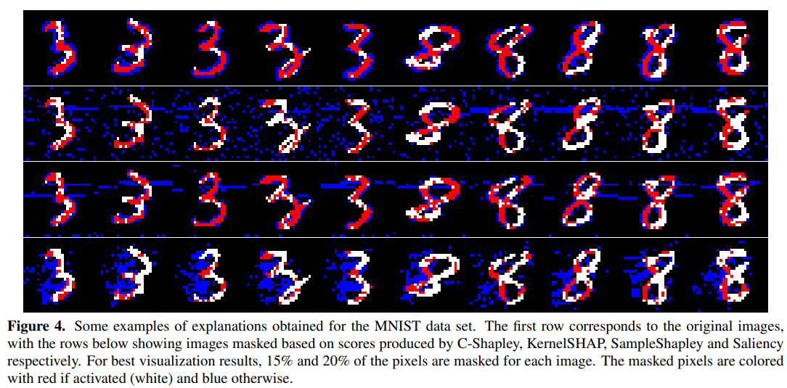
Results:
Pixels picked by C-Shapley concentrate around and inside the digits in MNIST.
Notes:
Here, we make the claim of this project.

Slide 27
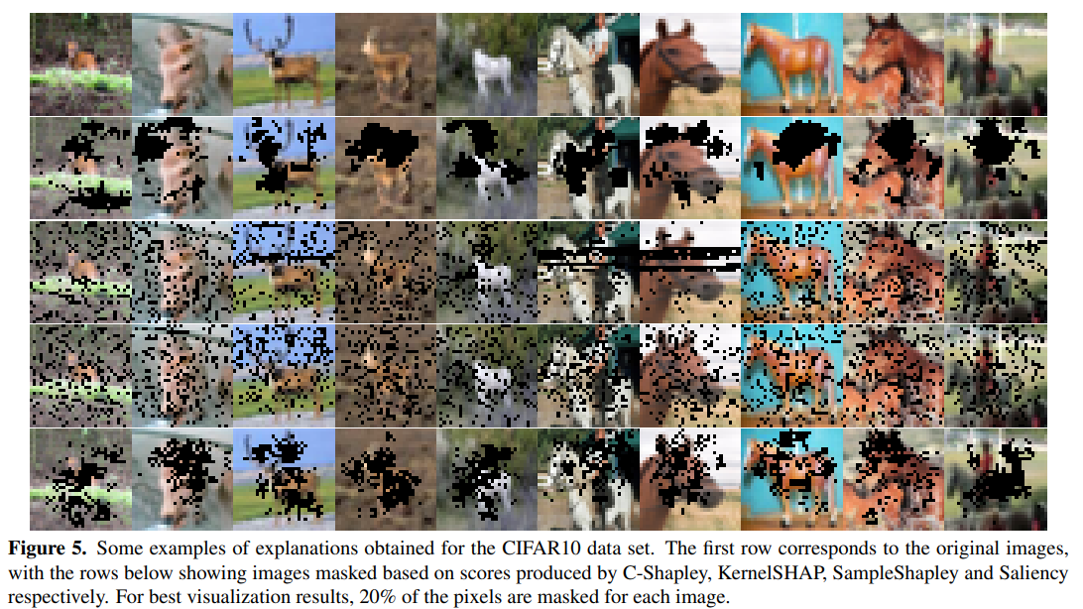
Results:
The C-Shapley and Saliency methods yield the most interpretable results in CIFAR10. In particular, C-Shapley tends to mask the parts of head and body that distinguish deers and horses, and the human riding the horse.
Notes:
Here, we make the claim of this project.

Slide 28
Conclusion:
Authors have proposed L-Shapley and C-Shapley for instance-wise feature importance scoring, making use of a graphical representation of the data.
Shown the superior performance of the proposed algorithms compared to other methods for instance-wise feature importance scoring in text and image classification.

Slide 29
References:
Sebastian Bach, Alexander Binder, Grégoire Montavon, Frederick Klauschen, Klaus-Robert Müller, and Wojciech Samek. On pixel-wise explanations for non-linear classifier decisions by layer-wise relevance propagation. PloS One, 10(7):e0130140, 2015.
David Baehrens, Timon Schroeter, Stefan Harmeling, Motoaki Kawanabe, Katja Hansen, and Klaus-Robert Müller. How to explain individual classification decisions. Journal of Machine Learning Research, 11:1803–1831, 2010.
Anupam Datta, Shayak Sen, and Yair Zick. Algorithmic transparency via quantitative input influence: Theory and experiments with learning systems. In Security and Privacy (SP), 2016 IEEE Symposium on, pages 598–617. IEEE, 2016.
Scott M Lundberg and Su-In Lee. A unified approach to interpreting model predictions. In I. Guyon, U. V. Luxburg, S. Bengio, H. Wallach, R. Fergus, S. Vishwanathan, and R. Garnett, editors, Advances in Neural Information Processing Systems 30, pages 4765–4774. Curran Associates, Inc., 2017.
Marco Tulio Ribeiro, Sameer Singh, and Carlos Guestrin. Why should I trust you?: Explaining the predictions of any classifier. In Proceedings of the 22nd ACM SIGKDD International Conference on Knowledge Discovery and Data Mining, pages 1135–1144. ACM, 2016.
Avanti Shrikumar, Peyton Greenside, and Anshul Kundaje. Learning important features through propagating activation differences. In ICML, volume 70 of Proceedings of Machine Learning Research, pages 3145–3153. PMLR, 06–11 Aug 2017.
Erik Štrumbelj and Igor Kononenko. An efficient explanation of individual classifications using game theory. Journal of Machine Learning Research, 11:1–18, 2010.
Mukund Sundararajan, Ankur Taly, and Qiqi Yan. Axiomatic attribution for deep networks. In International Conference on Machine Learning, pages 3319–3328, 2017.

